Slide 1
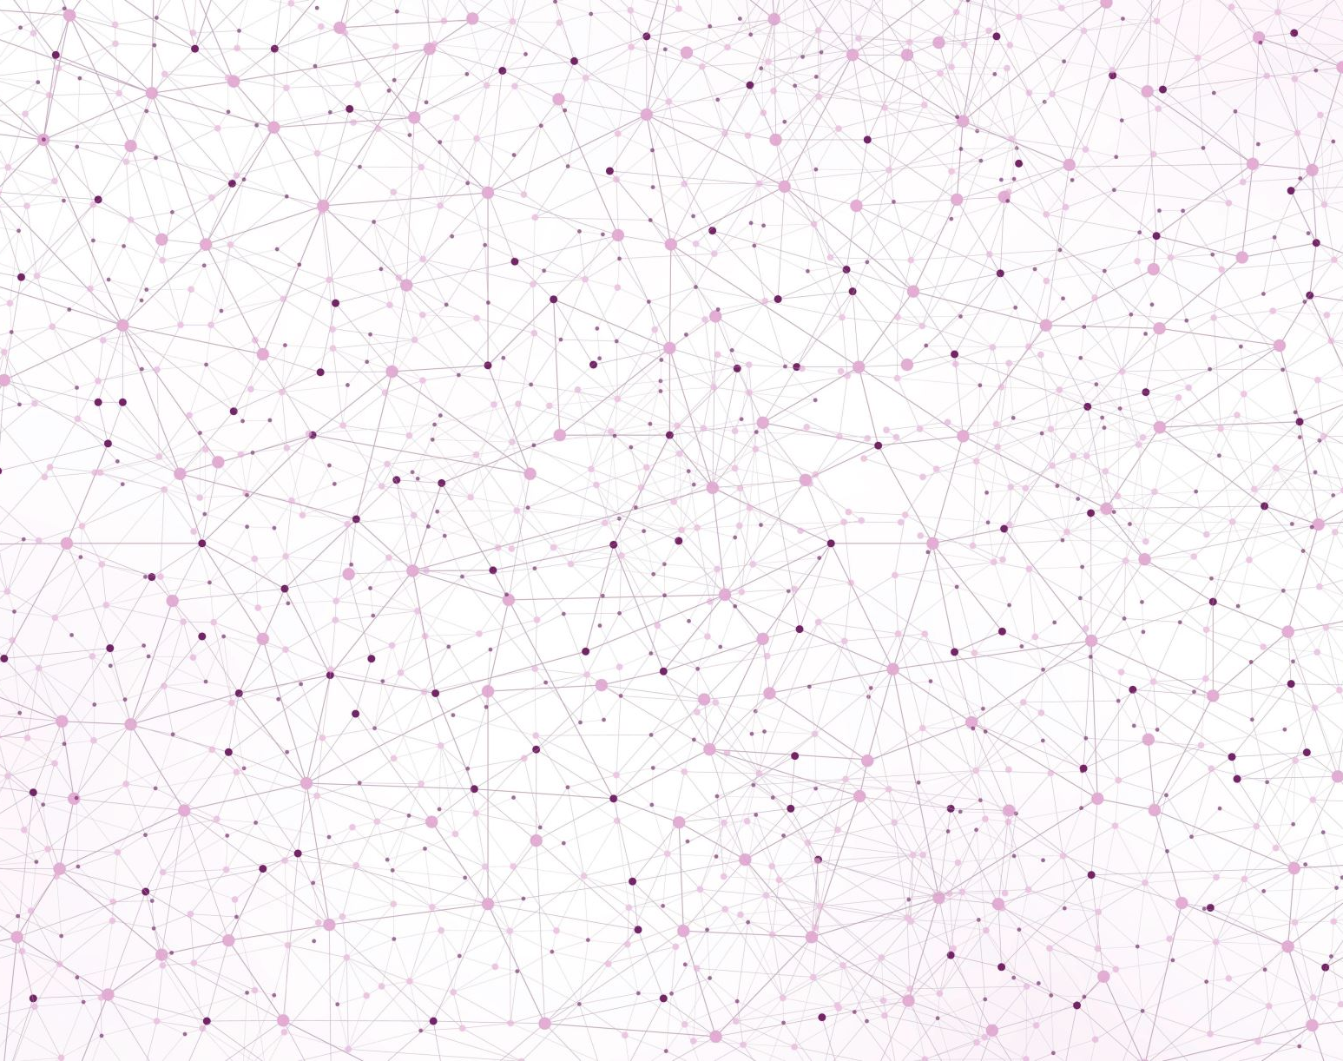
Deep Learning CAD Project Defense
Abdelrahman HABIB

Slide 2
Outline
Augmentation & Pre-processing
General augmentation/pre-processing
Hair augmentation (segmentation + augmentation)
Segmentation Masks
Architectures
Base Architecture with visual attention blocks
Ensemble 5-folds Architecture
Configurations (Experiments Controllers)
Results & Discussion
Conclusion

Slide 3
[1/6] Augmentation & Pre-processing _{(1/3)}
Train
Validation
Test
1. CropFrame ^{(a)}
8. OneOf (MotionBlur, MedianBlur, GaussianBlur, GaussNoise)
1. CropFrame^{(a)}
2. AdvancedHairAugmentation^{(a)}
2. Resize
3. HorizontalFlip
9. CLAHE
3. Normalize
4. VerticalFlip
10. Transpose
5. ColorJitter
11. HueSaturationValue
Returns:
- image
- segmentation mask ^{(b)}
- label ^{(c)}
6. Rotate
12. Resize
7. RandomBrightnessContrast
13. Normalize
Custom pre-processing function added to the augmentation transformer with probability (p), (1. p = 100%, 2. p=50%).
Depends on the experiment, we return the mask or None.
Random labels for test as we don’t use it (labels are generally based on the filename (class) and index.

Slide 4
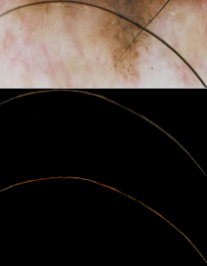
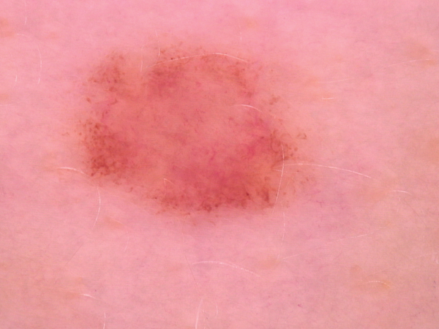
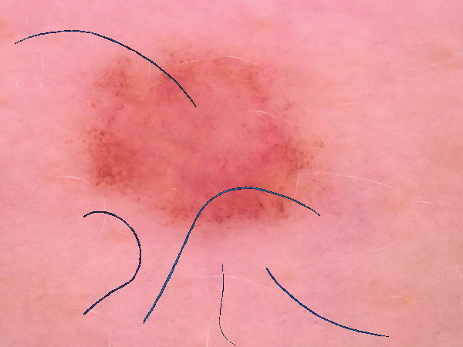
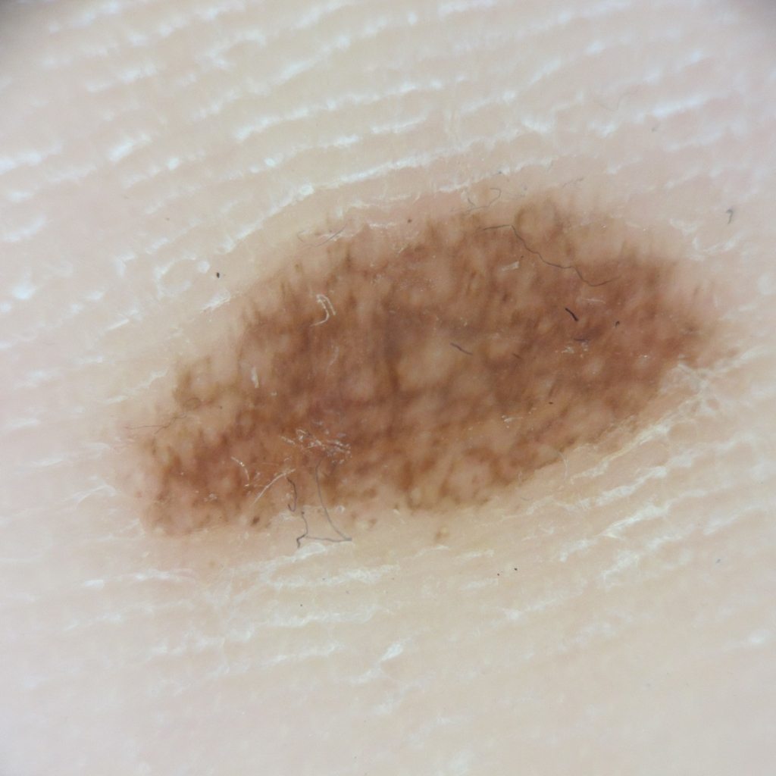
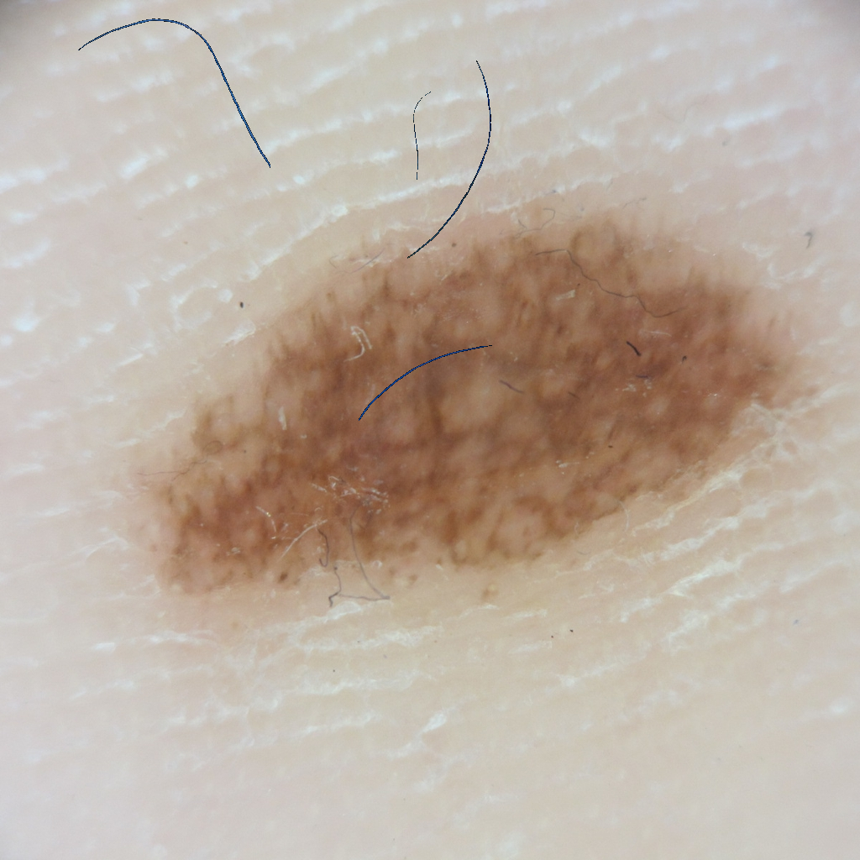
[1/6] Augmentation & Pre-processing – Hair Augmentation _{(2/3)}
Sample to segment
Manual Hair Segmentation
Resized, Adjusted Contrast
Segmented 5 hair samples from different lesions. The resize and contrast/intensity adjustment is to ensure that the augmented hair is small & dark. Hair is augmented with random rotation, flip, sizes, and maximum 5 new hairs in each image [0 to 5].
Notes:
Cite the author of the function

Slide 5
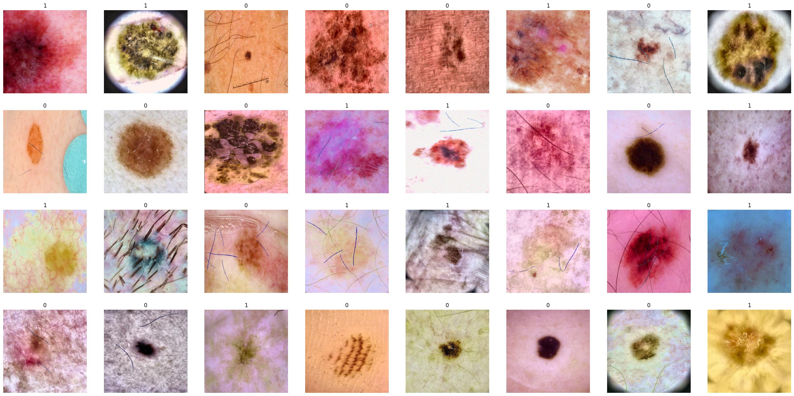
[1/6] Augmentation & Pre-processing (Results) _{(3/3)}

Slide 6
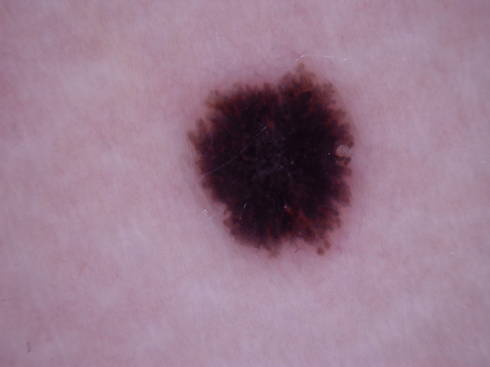
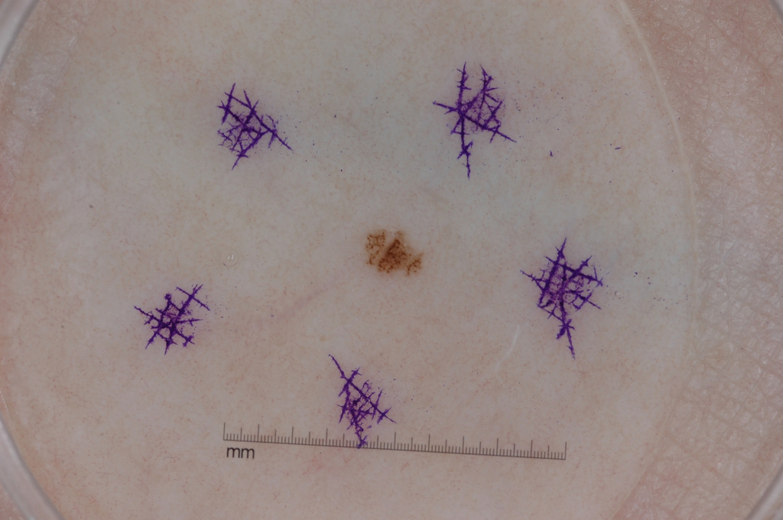
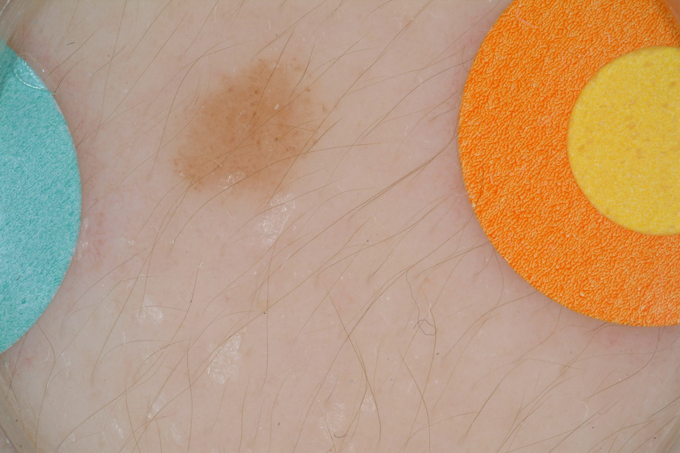
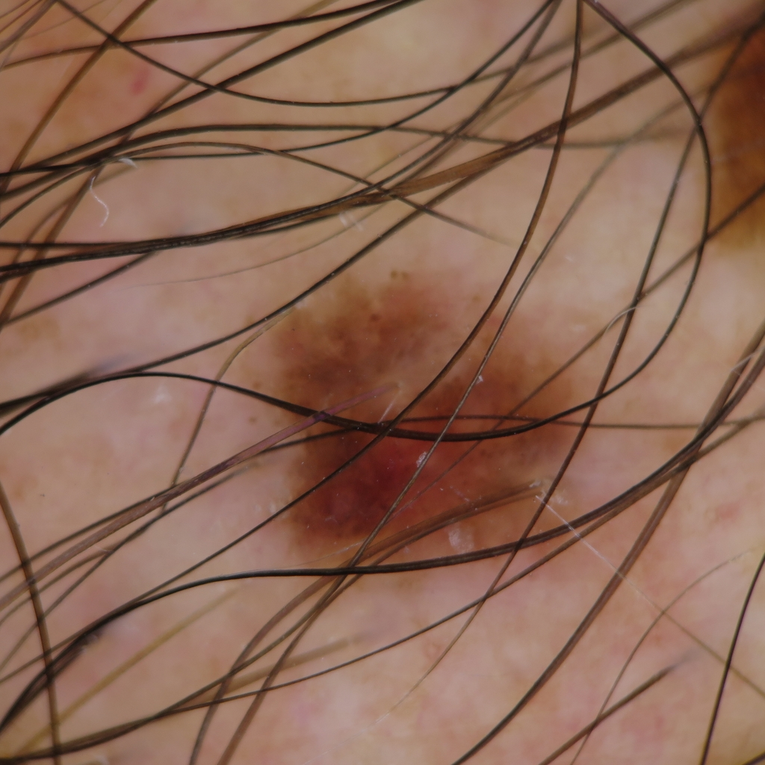
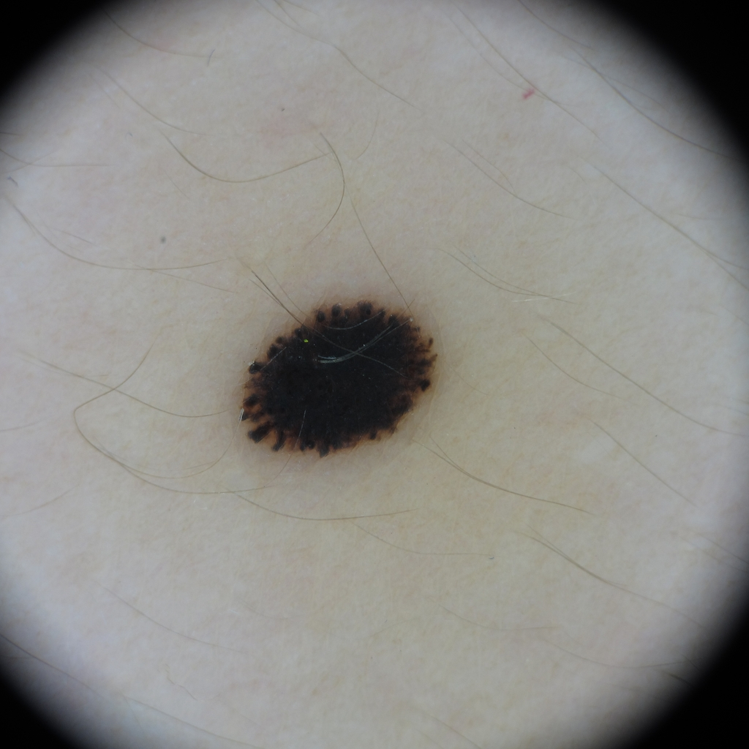
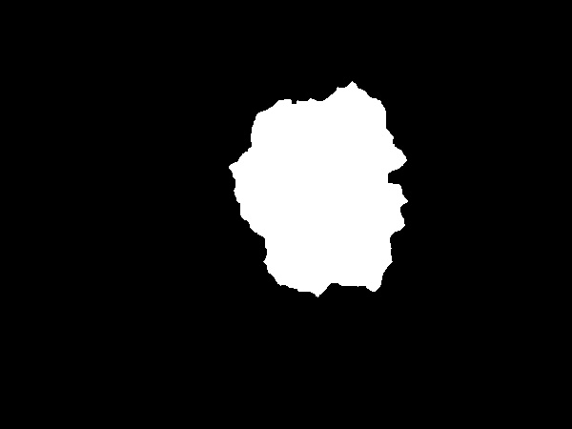
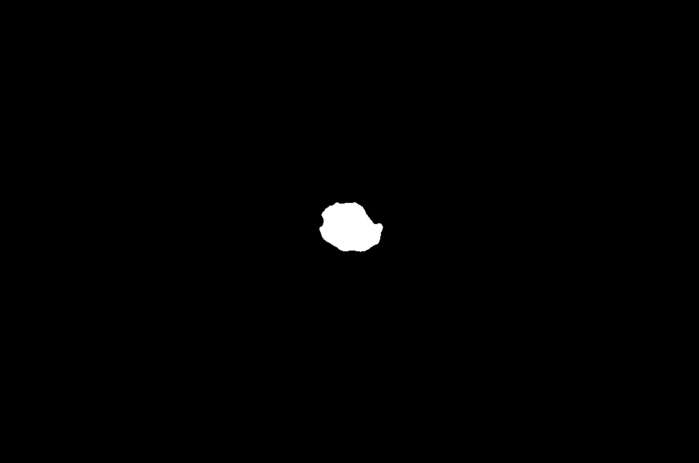
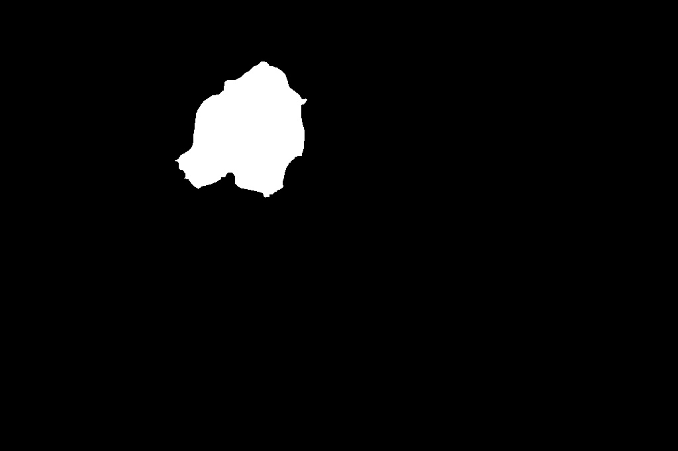

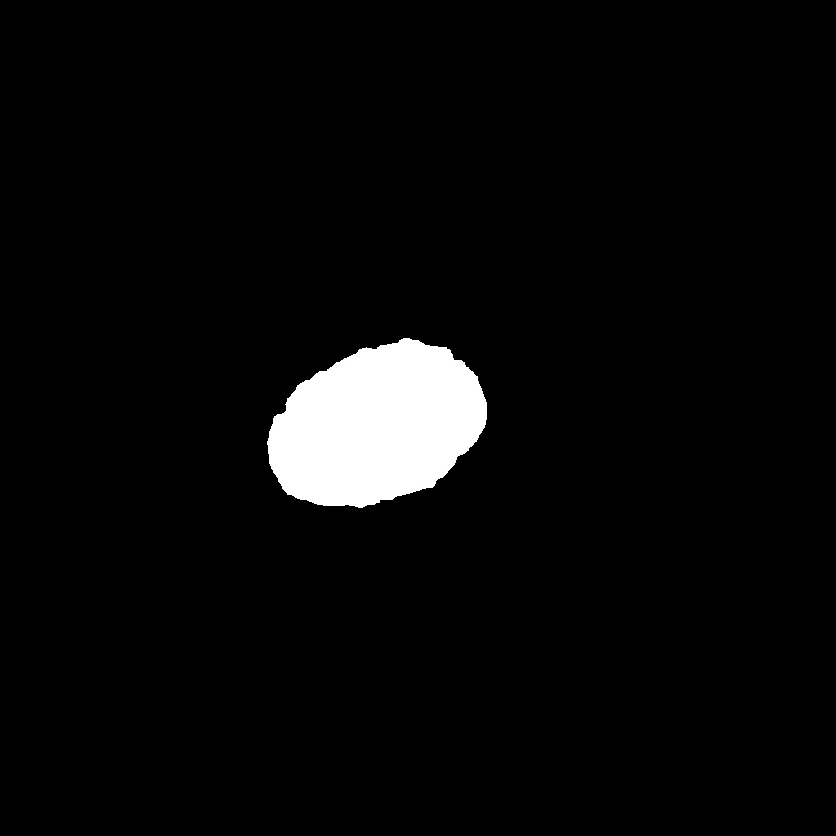
[2/6] Skin Lesion Segmentation _{(1/1)} ^{(*)}
Clear & simple to segment
Very small & similar objects surrounding
Multiple objects with lesion
A lot of hair on the lesion
Black corners surrounding
* Purely image processing! Detailed methodology can be found in the appendix slides, as this is an optional step in the project (yet improved the results).

Slide 7
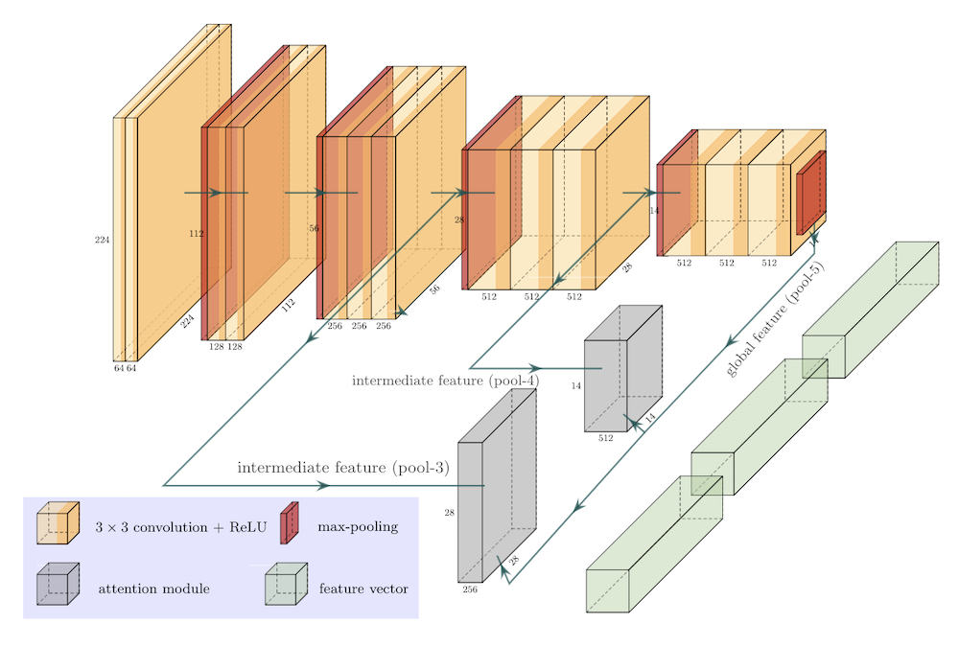
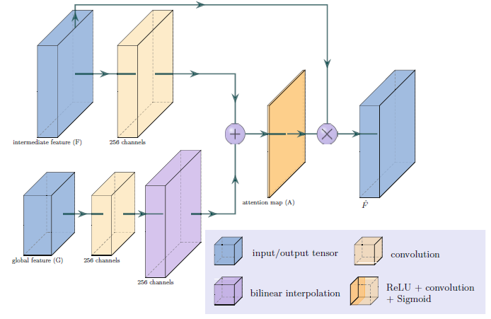
[3/6] Architectures (Base) _{(1/3)}
Outputs: features (that we combine) + attention masks
(that we use with our segmentation in the loss term)
Base Model VGG16_BN
Attention Blocks
X 2
Yan, Y., Kawahara, J., & Hamarneh, G. (2019). Melanoma recognition via visual attention. In Information Processing in Medical Imaging: 26th International Conference, IPMI 2019, Hong Kong, China, June 2–7, 2019, Proceedings 26 (pp. 793-804). Springer International Publishing.

Slide 8
[3/6] Architectures (Base) _{(2/3)}
Base Model VGG16_BN
Attention Blocks
Uses visual attention blocks, concatenates early features to classifier layer.
Model is trained from scratch! Loaded pre-trained weights and initialized the classifier and both attention blocks using ‘kaiming normal’.
Same base architecture for binary and multi-class problem.
They authors used a single model and claimed to be the state-of-the-art with a single model, reaching auc = 88% with masks. This model can work with/without masks. Can we do better?
We will discuss the loss and training configurations (with and without masks) in a later slide!

Slide 9
[3/6] Architectures (Ensemble) _{(3/3)}
VGG16_BN_Attention
Base Model VGG16_BN
Attention Blocks
Let’s call the entire model as VGG16_BN_Attention.
Our approach is to combine both train and valid splits, the split into k-folds using StratifiedKFold; k=5.
Train k-Models, on every split. This is one way to handle imbalance of challenge 2! Combine using majority voting.
More robust results, as the valid split is always balanced, more data to train.
Can work with/without masks; will be discussed later in the configuration slides.
Data
Fold 1
VGG16_BN_Attention
k=1
Majority/Weighted Voting
Predictions
…
…
Fold 5
VGG16_BN_Attention
k=5

Slide 10
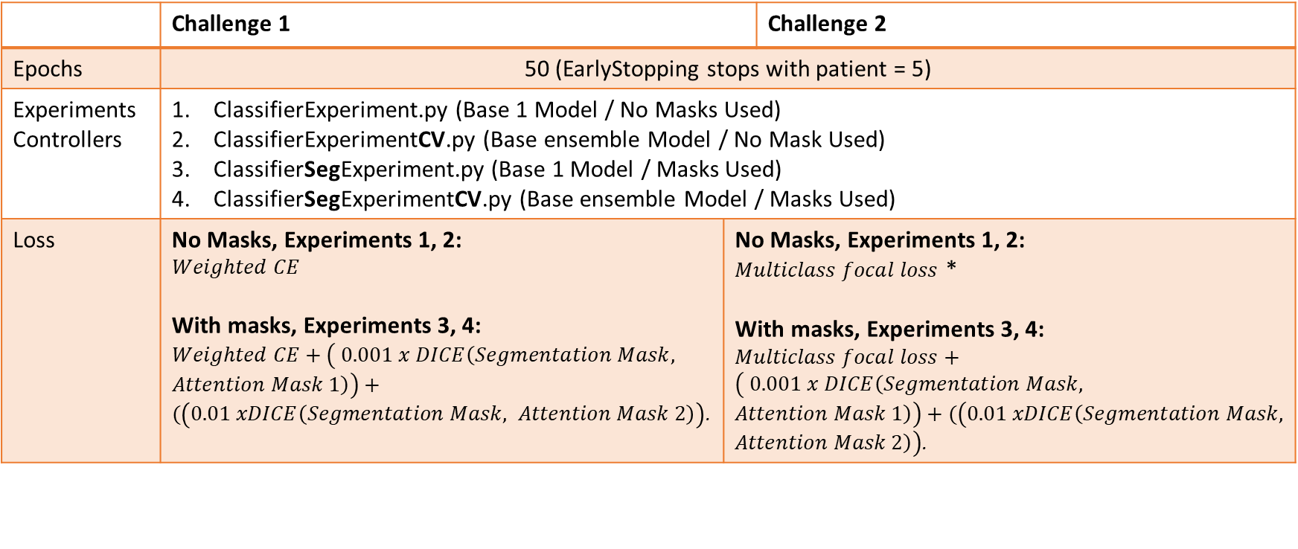
[4/6] Configurations
 | Challenge 1 |  | Challenge 2
Epochs | 50 (EarlyStopping stops with patient = 5)
Experiments Controllers | ClassifierExperiment.py (Base 1 Model / No Masks Used) ClassifierExperimentCV.py (Base ensemble Model / No Mask Used) ClassifierSegExperiment.py (Base 1 Model / Masks Used) ClassifierSegExperimentCV.py (Base ensemble Model / Masks Used)
Loss | No Masks, Experiments 1, 2: $$Weighted CE$$ With masks, Experiments 3, 4: $Weighted CE+\left( 0.001 x DICE\left(Segmentation Mask, Attention Mask 1\right)\right)+(\left(0.01 xDICE\left(Segmentation Mask, Attention Mask 2\right)\right)$. | No Masks, Experiments 1, 2: $Multiclass focal loss$ * With masks, Experiments 3, 4: $Multiclass focal loss+\left( 0.001 x DICE\left(Segmentation Mask, Attention Mask 1\right)\right)+(\left(0.01 xDICE\left(Segmentation Mask, Attention Mask 2\right)\right)$. | 1. Multi-class focal loss (No Masks, Experiments 1, 2) 2.
* Multi-class focal loss is initialized with weighted CE, making it handle class imbalance for challenge 2.
* The attention blocks outputs features plus an attention mask. We compare it to the segmentation we made and produce a loss that is only used in the training loop to control the overall training loss based on the attention mask accuracy!
* The only difference between attention mask 1 and 2 are the sizes (different scale factor used).

Slide 11
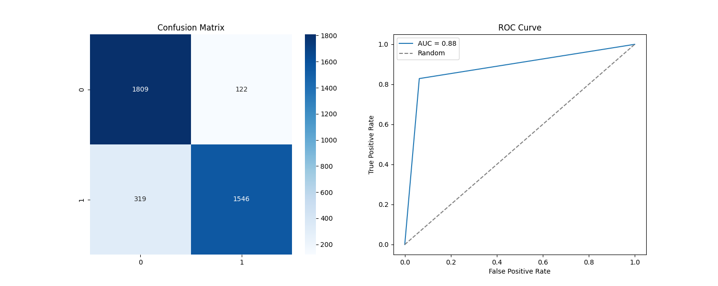
[5/6] Results and Discussion – Challenge 1 _{(1/4)}
Single (Base) model results, trained on training split only.
Config: Preprocessing + ( Hair + overall) Augmentation + Masks.
Accuracy: 88.3825
AUC: 88.2887
Kappa: 76.7159
Target 0: Sensitivity: 93.6820
Target 1: Sensitivity: 82.8954
Ensemble model was used for testing as it obtained the best validation results, not the base single models.

Slide 12
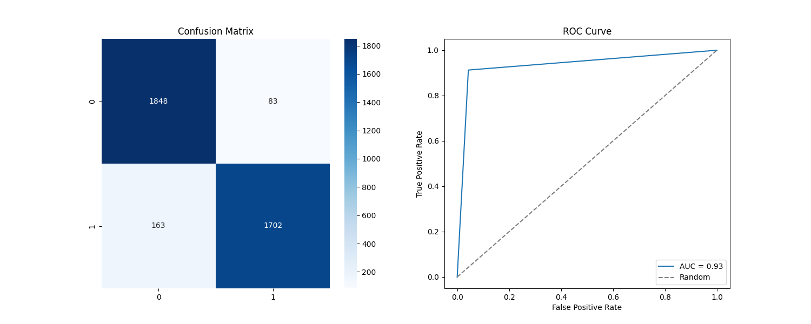
[5/6] Results and Discussion – Challenge 1 _{(2/4)}
Ensemble model results, trained using k=5 folds.
Config: Preprocessing + ( Hair + overall) Augmentation + Masks.
Accuracy: 93.5194
AUC: 93.481
Kappa: 87.0255
Target 0: Sensitivity: 95.7017
Target 1: Sensitivity: 91.2600
+ 5.1369
+ 5.1923
+ 10.3096
+ 2.0197
+ 8.3646
+ number – improvement made by the ensemble.
Ensemble model was used for testing as it obtained the best validation results, not the base single models.

Slide 13
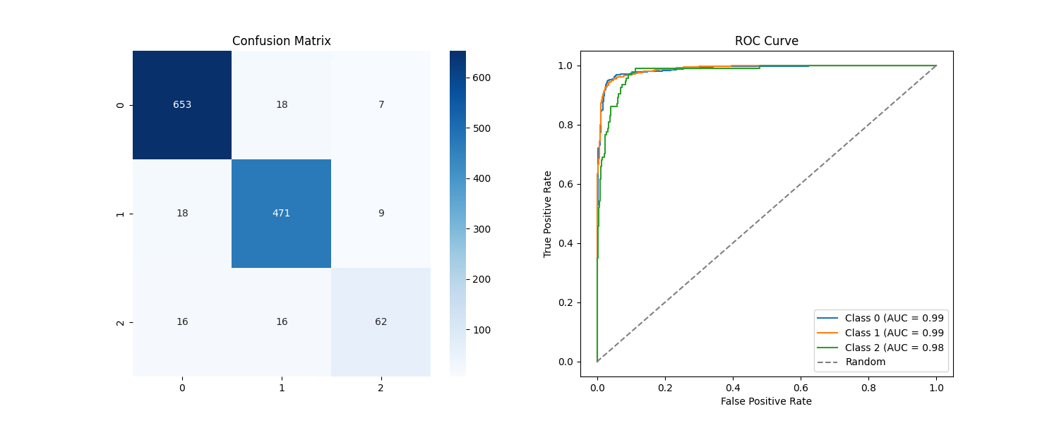
[5/6] Results and Discussion – Challenge 2 _{(3/4)}
Single (Base) model results, trained on training split only.
Config: Preprocessing + ( Hair + overall) Augmentation + Masks.
Accuracy: 93.3858
AUC: 98.4695
Kappa: 87.9904
Target 0: Sensitivity: 96.3127
Target 1: Sensitivity: 94.5783
Target 2: Sensitivity: 65.9574
Ensemble model was used for testing as it obtained the best validation results, not the base single models.

Slide 14
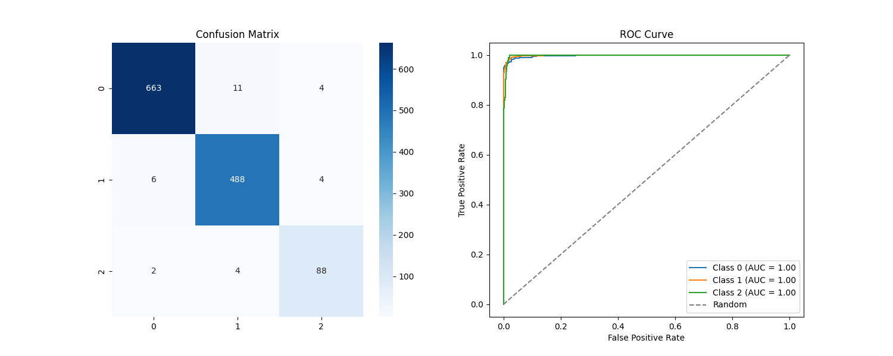
[5/6] Results and Discussion – Challenge 2 _{(4/4)}
Ensemble model results, trained using k=5 folds.
Config: Preprocessing + ( Hair + overall) Augmentation + Masks.
Accuracy: 97.5591
AUC: 99.8111
Kappa: 95.6179
Target 0: Sensitivity: 97.7876
Target 1: Sensitivity: 97.9919
Target 2: Sensitivity: 93.6170
+ 4.1733
+ 1.3416
+ 7.6275
+ 1.4749
+ 3.4136
+ 27.6596
+ number – improvement made by the ensemble.
Ensemble model was used for testing as it obtained the best validation results, not the base single models.

Slide 15


[6/6] Conclusion
Skin Hair Dataset
GitHub Repository
Link to skin hair dataset & segmentation masks datasets
Link to the best models and their logs, results

Slide 16
[Appendix] Skin Lesion Segmentation

